Slide 1
Command and Staff COLLEGE
Blended Seminar program
Graduation
1 November 2019
Camp Pendleton

Slide 2
Program
Invocation
LCDR Shawn Bootsma, Chaplain Corps
National Anthem
Introductory Remarks
Mr. Jeff Willis
Regional Director, CDET
Introduction of Guest Speaker
Guest Speaker
Brigadier General Thomas B. Savage, USMC
Deputy Commanding General, I Marine Expeditionary Force
Presentation of Diplomas
Marines Hymn

Slide 3
Welcome, and thank you for attending the Graduation Ceremony for the Camp Pendleton Region Command and Staff College Blended Seminar Program Course 909/910 for Academic Year 2020.
While approximately 20% of Marine Corps active duty officers attend a one-year resident intermediate-level school, the vast majority complete their professional studies through distance education programs offered by the Marine Corps University’s College of Distance Education and Training.
Several years ago, the Commandant of the Marine Corps directed an expansion of the opportunities for officers to receive a "resident school-like experience.” This initiative was to become the Blended Seminar Program (BSP). Today, Blended Seminar Programs are offered through regional campuses at Camp Lejeune, Camp Pendleton, Hawaii, and Okinawa.
BSP provides a resident-like experience through two periods of resident instruction with the balance of the course conducted in an online format. The course is supported by a full-time faculty of both active duty and retired Marines. This highly qualified staff carries each class through the entire program, much like the resident school. In addition to leading the seminars, faculty also serve as role models and mentors. These faculty members deserve a special "thank you." Without their hard work and dedication, it would not have been possible to accomplish the goals of the program.
Over the past eleven months, the program has covered topics, such as the Theory and Nature of War, National and International Security, Joint Operations, Small Wars, MAGTF Amphibious and Expeditionary Operations, and the Marine Corps Planning Process. Additionally, learners gained many benefits normally afforded only through a full-time resident program. These included guest speakers and guided discussions with leaders from all elements of the MAGTF, to include General Officers. It also included Joint leadership engagements and many curriculum enhancing site visits.
In addition to providing exceptional resident-like education, the BSP develops officers who are proficient planners, strong MAGTF leaders and competitive for promotion and command. I am confident that each officer graduating today leaves the program a better leader than when they entered.
The entire team at the Camp Pendleton Region College of Distance Education and Training wishes to extend our "Congratulations" to today's graduates. It has been our pleasure to serve you.
Semper Fidelis,
Jeffrey R. Willis, Regional Director

Slide 4
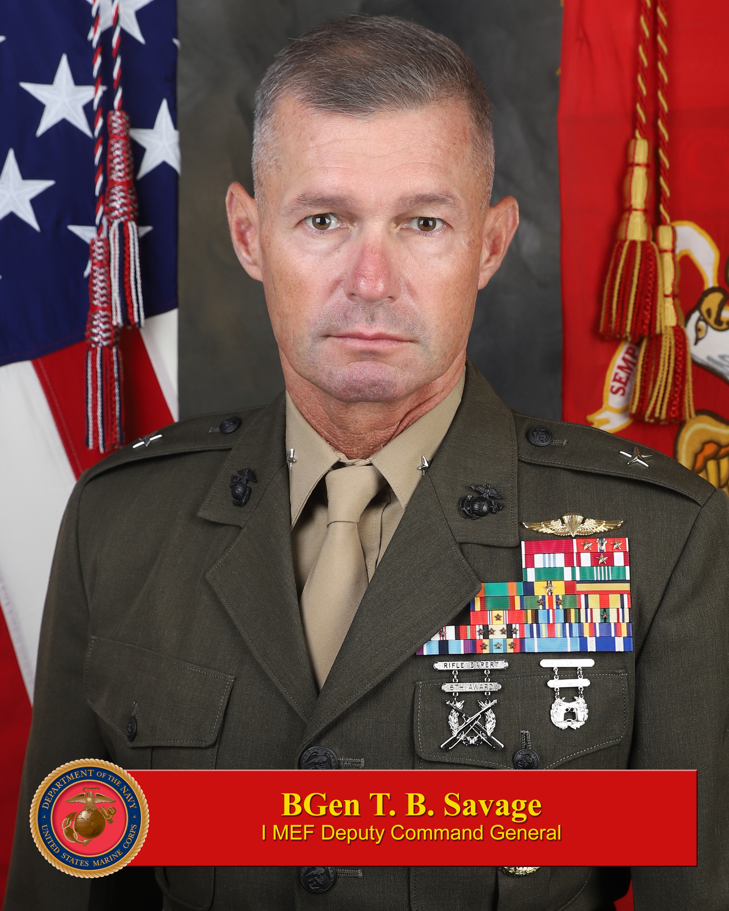
Brigadier General Thomas B. Savage, USMC
Deputy Commanding General, I Marine Expeditionary Force
Brigadier General Savage is currently serving as Deputy Commanding General I Marine Expeditionary Force. He is a graduate of California State University and was commissioned in August 1991. He has attended The Basic School, Infantry Officer Course, U.S. Army Infantry Captain Career Course, Marine Corps Command and Staff College, the School of Advanced Warfighting, the Naval War College, and the United Kingdom Higher Command and Staff Course. He has also completed Army Ranger School, Army Airborne School, and the USMC Basic Reconnaissance Course.

Slide 5
His service in the Operating Forces includes: Platoon Commander with 1st Battalion, 9th Marines (June 1992-June 1994); Company Executive Officer with 2nd Battalion, 1st Marines (June 1994-January 1996); Logistics Officer, Company Commander, and Operations Officer for 3rd Battalion, 5th Marines (May 1999-August 2002); Aide de Camp to the Commanding General I Marine Expeditionary Force (August 2002-June 2004); G-3 Operations Officer 1st Marine Division (July 2006-June 2007); Operations Officer and Executive Officer for 1st Marine Regiment (June 2007-January 2010); Commanding Officer for 1st Battalion, 5th Marines (January 2010-January 2012); Commanding Officer Headquarters Battalion 1st Marine Division (January 2012- June 2012); Commanding Officer 2nd Marine Regiment (August 2014-March 2016); Assistant Division Commander, 2D Marine Division (March 2016 – June 2016).
His service outside the Operating Forces includes duty as an Amphibious Raid Instructor at Special Operations Training Group, Atlantic from January 1996 to May 1997, and as the Assistant Officer in Charge of the Amphibious Reconnaissance School from August 1997 to January 1998. From September 2013 to June 2014 he served as a Fellow on the Chief of Naval Operations Strategic Studies Group. He served as a Strategic Plans Advisor for the Deputy Assistant Secretary of Defense for Plans, Office of Secretary of Defense (Policy) from June 2016 to July 2018, and as the Executive Assistant to the Deputy Commandant for Plans, Policies, and Operations, Headquarters Marine Corps from July 2018 to July 2019.

Slide 6
Command and staff college
Blended seminar program graduates
Major Frank K. Anderson III, USMC
LCDR Shawn L. Bootsma, USN
Major Mitchell E. Borley, USMC
Major Joel W. Graves, USMC
CWO4 Michael A. Higuera, USMC
LtCol Khorolsuren Jamsran, Mongolian Armed Forces
Captain Jared A. Mason, USMC
Major Blair McNaught, Canadian Armed Forces
Major Kevin P. Morrisey, USMC
Major Aaron P. Pinson, USAF
Major Jesse R. Simoneau, USMC
Major Mitchell R. Spidel, USMC
LCDR Daniel A. Tanguis Bedoya, Peruvian Navy
Major Shawn C. Wehrle, USMC
Major James W. Woods, USMC

Slide 7
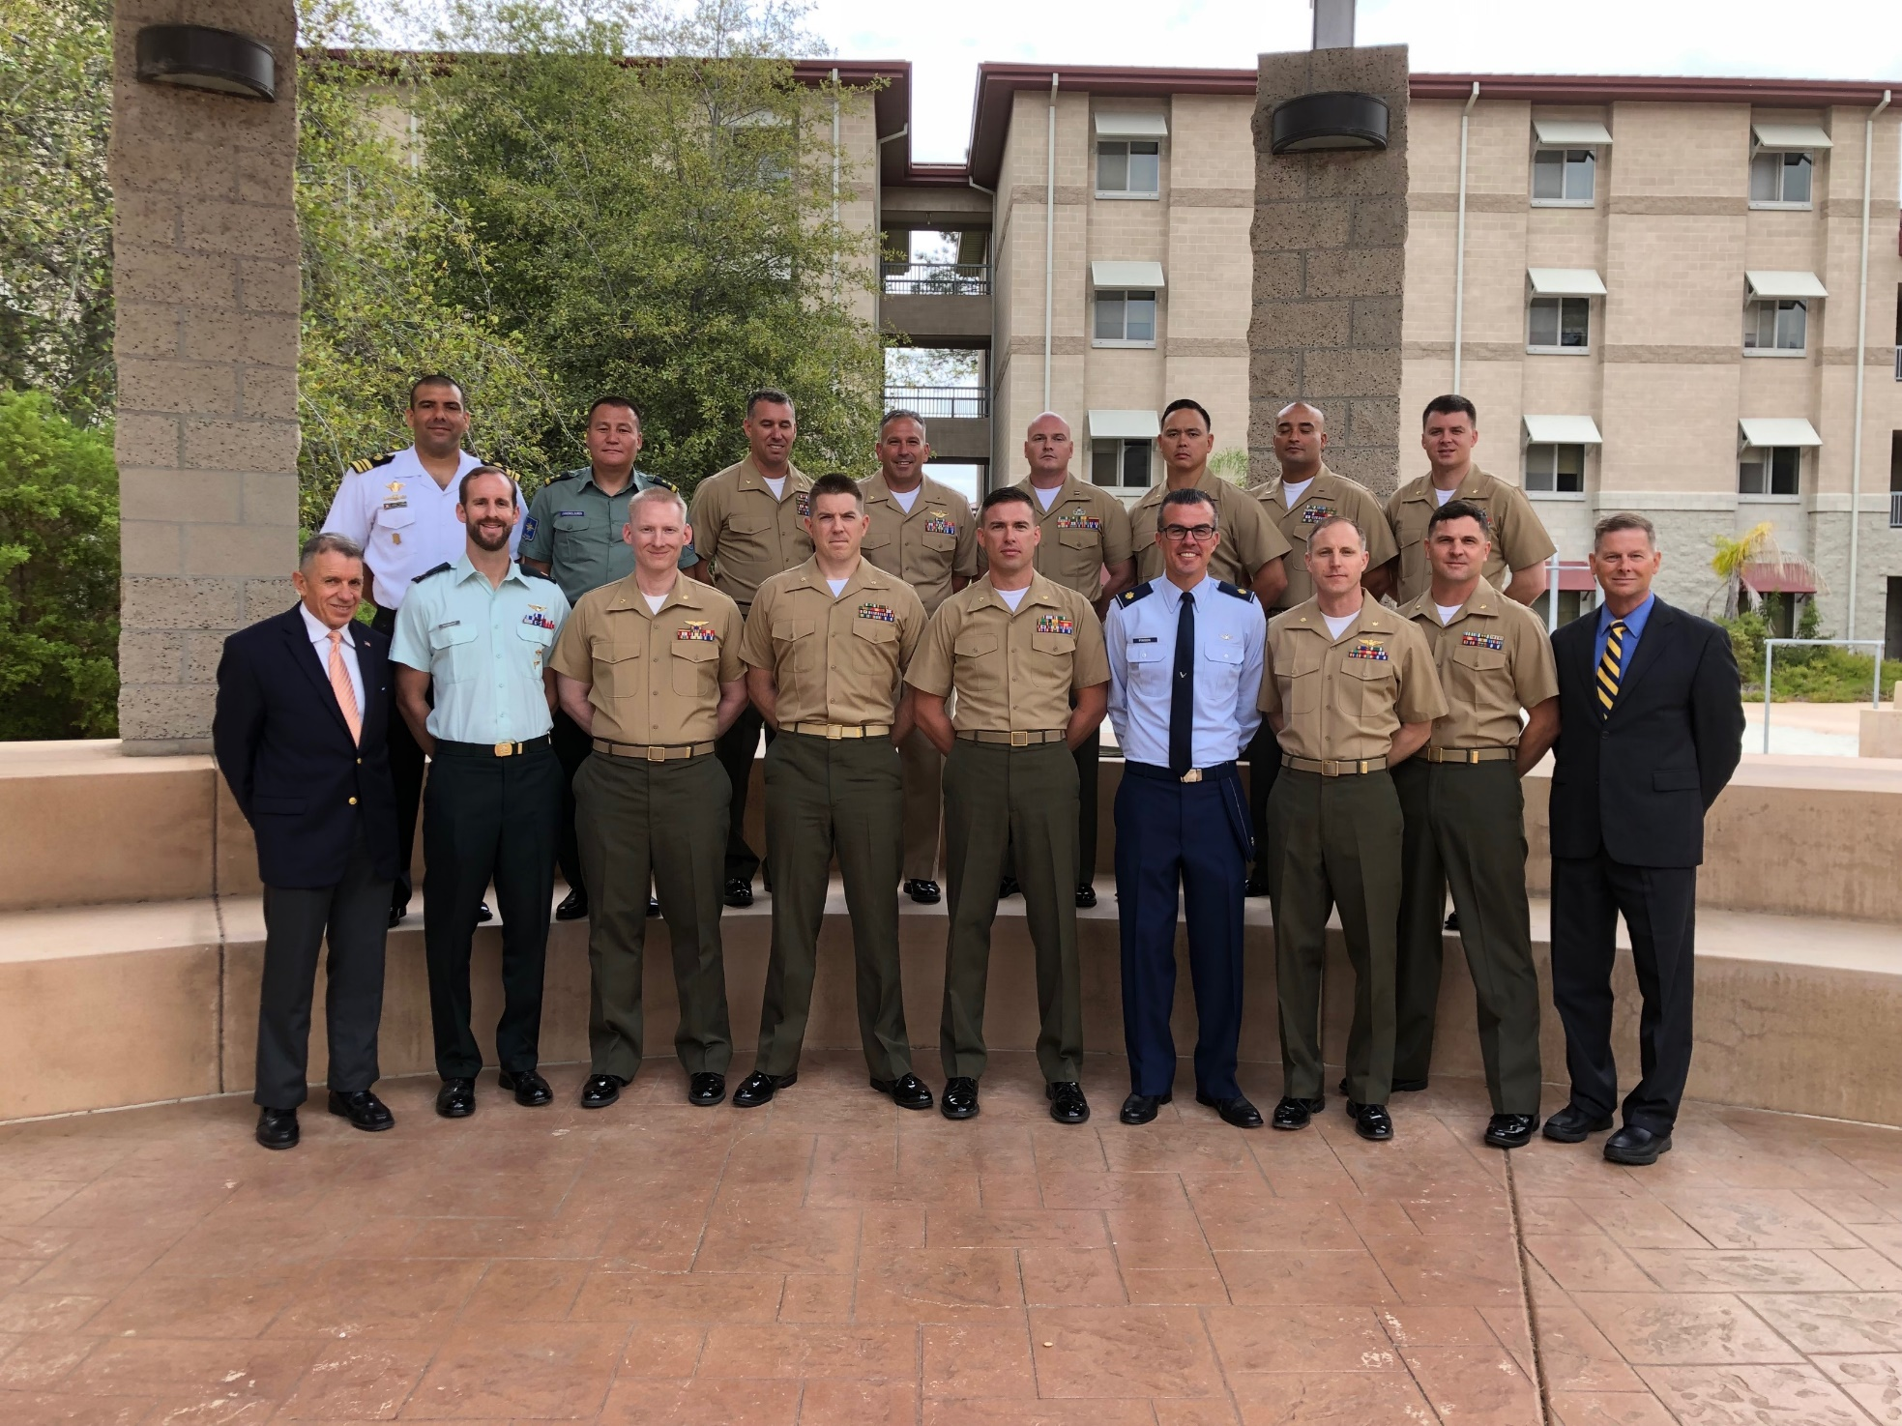

Slide 8
CSC BSP Faculty
Mr. Mark Desens, CSC BSP Faculty
Mr. Hank Donigan, CSC BSP Faculty
Campus Staff
Mr. Jeff Willis, Regional Director
LtCol Edward Silva, USMC, Head, BSP
Major Nathan Hatfield, USMC, EWS BSP Faculty
Mr. Stefen Bien, EWS BSP Faculty
Mr. Willy Buhl, EWS BSP Faculty
Mrs. Monica Castillo, Administrative Assistant ECDEP
Mr. Jack Hall, Regional Chief Instructor CSC DEP
Mr. Rob Hightower, Regional Chief Instructor ECDEP
Mrs. Kerrie Parsons, Administrative Assistant OPME
Mr. Jim Woulfe, Regional Chief Instructor EWS
Mr. Harrison Tanksley, Regional Chief Instructor ECDEP
Mr. Tye Wallace, EWS BSP Faculty

